Slide 1
Statistics for Cyber Security
Wenyaw Chan
Department of Biostatistics
School of Public Health
University of Texas
- Health Science Center at Houston

Slide 2
Module (b): Correlation and Linear Regression

Slide 3
Causation and Association
Causation – Changes in A cause changes in B
Association: The relationship between the two variables.

Slide 4
Causation and Association
Causation
After a law compelling motorists to wear seat belts
went into effect, an increasing percentage of motorists
complied. A study found high positive correlation
between the percent of motorists wearing seat belts
and the percent reduction in injuries from the day the
law went into effect.
This is an instance of cause and effect: Seat belts
prevent injuries when an accident occurs, so an
increase in their use caused a drop in injuries.

Slide 5
Causation and Association
Association
A moderate correlation exists between the
Scholastic Aptitude Test (SAT) scores of high
school students and their grade index later as
freshman in college. Surely high SAT scores do
not cause high freshman grades. Rather the same
combination of ability and knowledge shows
itself in both high SAT scores and high grades.
Both of the observed variables are responding to
the same unobserved variable and this is the
reason for the correlation between them.

Slide 6
Association of Two Variables
To Summarize Data taken from One Variable: Mean, Median, Mode, quantiles, Variance, Standard Deviation, Range, etc.
To Summarize Data taken from Two Variables:
Summary statistics of each variable and the association of the two. The association statistics include correlation, covariance, contingency table (discrete) and Regression equation (continuous).

Slide 7
Association of Two Variables
X Y Method
Dichotomous Continuous Two-sample t test
Polytomous Continuous One-Way ANOVA
Categorical Categorical Chi-Square test
or Kappa statistics
Continuous Continuous Linear Regression
Continuous Dichotomous Logistic Regression
or Discrete

Slide 8
Linear Regression
Simple Linear Regression
,where are independent random variables
is another observable variable
is the intercept
is the slope
is normally distributed with mean=0 and variance=

Slide 9
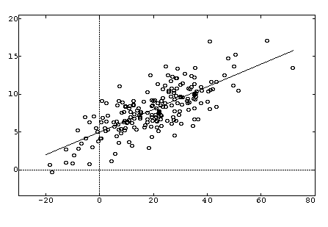
Fitting a Linear Regression Model

Slide 10
Fitting a Linear Regression Model
To fit a linear regression model , we
minimize the sum of squared deviations
This method is called the method of least squares.

Slide 11
Simple Regression
From the method of least squares,
we can obtain the estimates of and as
where and

Slide 12
Simple Regression
The predicted value of y for a given value of x is
.
The properties of the Least Square estimators:
1.
2. have minimum variances among unbiased estimators (called Gauss-Markov property).
The residual is defined as . The sum of all the residuals is zero.
The regression line always goes through the point .

Slide 13
Linear Regression Interpretation of the Coefficients
In a linear regression model, means the
expected rate of increase or decrease in Y
for each unit increment of x. When x
increases by one unit, the mean of Y
increases by units.
In a linear regression model, means the
expected value of Y when x=0.

Slide 14
Simple Regression
In the above equation,
If , then the scatter plot of (x,y) forms a line.
If >0, then as x increases, the expected value of y increases.
If <0, then as x increases, the expected value of y decreases.
If =0, then there is no relationship between x and y.

Slide 15
Simple Regression
Example:
Let Y be the number of computers cleaned for every 1000 times
that the Malicious Software Removal Tool is run for a country
and X be the country’s gross income per capita.
Then the regression model could be
, where represents the country.
Here, we assume that and

Slide 16
Regression and Correlation
is the sample correlation between X and Y.
is the sample standard deviation of X.
is the sample standard deviation of Y.

Slide 17
Some Observations of Linear Regression
1) If we didn’t have the regression line, we would use as an estimate of the yi ’s.
2) So is the distance our estimate is from our actual value.
3) The (directional) distance from yi to the line is This difference is called the residual component. This residual is the distance our regression estimate is from the actual variable even though we have the line. So we have improved our estimate but we still are somewhat off from the actual value.

Slide 18
Some Observations of Linear Regression
4) The distance by which we have improved our estimate for yi is .
This difference is called the regression component.
We have
Total sum of squares = residual sum of squares + regression sum of squares.

Slide 19
An ANOVA Table for Simple Linear Regression F-Ratio=MSR/MSE df=1,n-2 for testing H0:slope=0
Source | Sum of Squares | Degrees of Freedom | Mean Squares
Model |  | 1 | MSR =SSR/1
Residual |  | n-2 | MSE= SSE/n-2
Total |  | n-1

Slide 20
Extension to Multiple Linear Regression
To fit a multiple linear regression model
we minimize the sum of squared deviations

Slide 21
Multiple Linear Regression Interpretation of the Coefficients
In a multiple linear regression model,
means the expected units of increase or
decrease in Y for each unit increment of
when all other x’s are held constant.

Slide 22
Correlation Coefficient
The correlation coefficient measures the strength of linear relationship.
1) If all we want to know is the size of the correlation coefficient, then X and Y
should be continuous variables, but neither of them has to be normally distributed.
2) However, the associated hypothesis test is only valid if the pair (X,Y) are randomly selected.

Slide 23
Correlation Coefficient

Slide 24
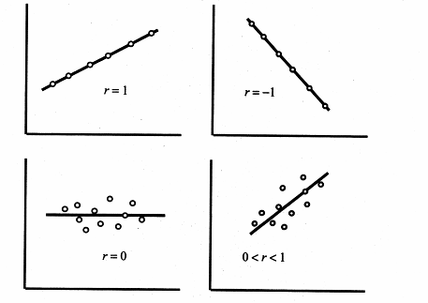
Correlation Coefficient

Slide 25
Outliers and Influential Points in a Linear Regression
An outlier is an observation that appears at one of the extremes of the data range (eg: data points more than 2 sd away from the mean, .
In a linear regression, an outlier can be evaluated based on three criteria: reasonableness, response extremeness and predictor extremeness (eg: a data point that has a unusually large residual).
An influential point is a point which has an important influence on the coefficients of the fitted regression lines.
Outliers and influential points are not necessary the same. An outlier may or may not be influential, depending on its location relative to the remaining sample points.

Slide 26
Use of Outliers to Detect the Security Attack
Outlier detection is to find patterns in data that do not conform to expected normal data behavior.
Outlier detection has been a widely researched problem and find immense use in cyber security.
This can be used for detecting malicious computer break-ins, called intrusion detection.
Application of Outlier detection in this domain usually involves a huge volume of data.

Slide 27
Application of Regression Model in Computer Security
Y=Security breach rate.
X1=number of potential adversaries
X2=incentives of each adversary
X3=cost of attacks
X4=risk of attacks
We can then run a linear regression model to predict the security breach rate using X1-X4.

